Slide 1
University Database
Krishna vardhini K

Slide 2
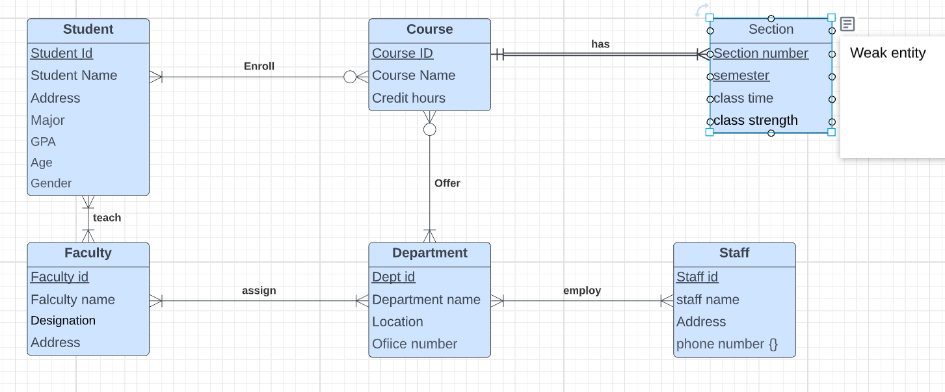
EERD of University

Slide 3
METADATA :
Entity : Student_1
Attributes | Datatype | Description | Required/Optional
Student Id | char(4) | Student Id with alpha numeric charaters (primary key) | Required
Student Name | varchar(20) | Student first name and last name | Required
Address | varchar(50) | Student address | Required
Major | char(10) | Student Major of the degree | Required
GPA | double(4) | Average Grade details | optional
Age | int(2) | Age of the student | Required
Gender | char(6) | Male or female | Required
Entity : Course
Attributes | Datatype | Description | Required/Optional
Course Id | char | Course Id as alpha numeric character(primary key) | Required
Course Name | varchar(10) | course name as variable character | Required
Course Hours | time(8) | Course time window in hours | Required
Entity : Section
Attributes | Datatype | Description | Required/Optional
Section number | char(2) | Section number of the course as identifying key | Required
semester | char(2) | semester details (fall/spring/summer) as identifying key | Required
class time | time(8) | Section time window | Required
class strength | int(2) | Total strength of each section | optional
Entity : Faculty
Attributes | Datatype | Description | Required/Optional
Faculty Id | int(5) | Faculty Id in numbers(primary Key) | Required
Faculty Name | varchar(15) | Faculty first name and last name | Required
Designation | char(15) | Designation of the faculty | Required
Address | varchar(20) | Address of the faculty | Required
Department | Char(15) | Department of the faculty | Required
Salary | Decimal | Salary of faculty | Required
Entity : Department
Attributes | Datatype | Description | Required/Optional
Dept id | char(5) | Department Id(primary key) | Required
Department Name | char(10) | Department Name | Required
Location | varchar(15) | Department building name | Required
Office Number | int(10) | Office phone number with extension number | Required
Entity : Staff
Attributes | Datatype | Description | Required/Optional
Staff Id | char(5) | staff member id (primary key) | Required
Staff name | varchar(15) | staff member name | Required
Address | varchar(20) | Address of the staff member | Required
Phone number | int(10) | 10 digit phone number | Required

Slide 4
Relation used for sub-query:
Faculty
Student_1
Course

Slide 5
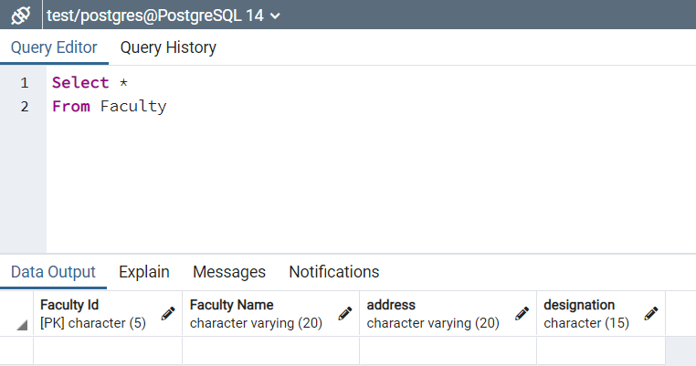
SQL QUERY of Faculty Relation:
Create at least one or two tables of the design. Output:
CREATE TABLE Faculty(
"Faculty Id" char(5) Primary Key ,
"Faculty Name" varchar(20),
Address varchar(20),
Designation char(15));

Slide 6
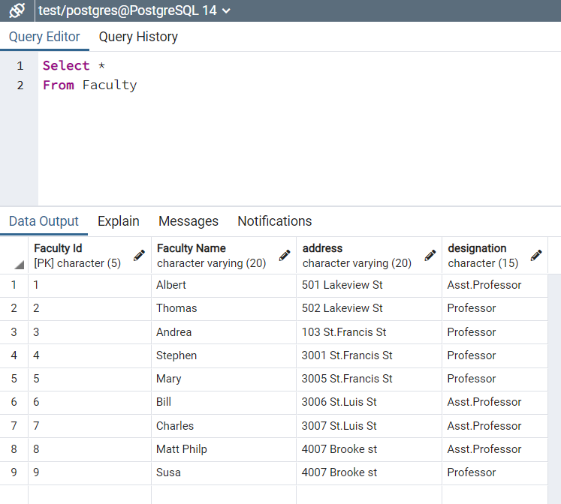
SQL QUERY
Output:
Insert at least tuples (rows) into faculty table using SQL queries.
INSERT INTO Faculty VALUES (1,'Albert','501 Lakeview St','Asst.Professor');
INSERT INTO Faculty VALUES (2,'Thomas','502 Lakeview St','Professor');
INSERT INTO Faculty VALUES (3,'Andrea', '103 St.Francis St','Professor');
INSERT INTO Faculty VALUES (4,'Stephen','3001 St.Francis St','Professor');
INSERT INTO Faculty VALUES (5,'Mary','3005 St.Francis St','Professor');
INSERT INTO Faculty VALUES (6,'Bill','3006 St.Luis St','Asst.Professor');
INSERT INTO Faculty VALUES (7,'Charles', '3007 St.Luis St','Asst.Professor');
INSERT INTO Faculty VALUES (8,'Matt Philp', '4007 Brooke st','Asst.Professor');
INSERT INTO Faculty VALUES (9,'Susa','4007 Brooke st','Professor');

Slide 7
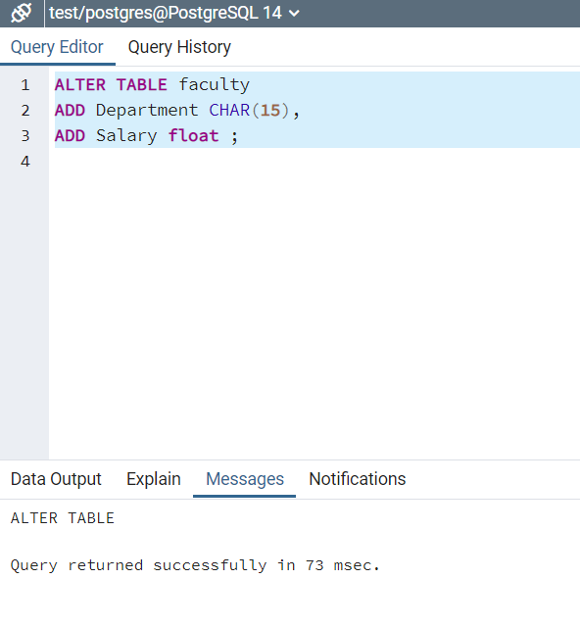
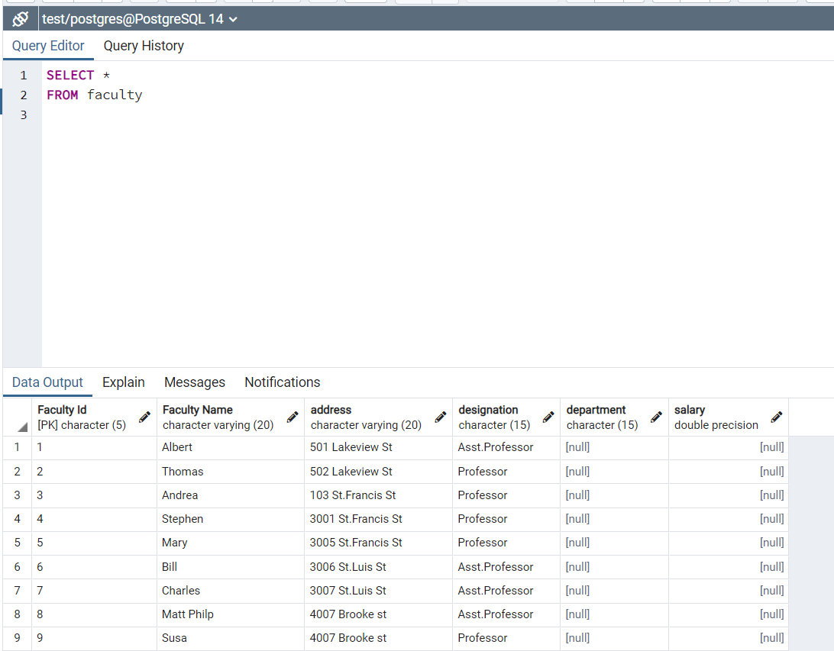
SQL QUERY
Add columns of a table Faculty using SQL queries.
ALTER TABLE faculty
ADD Department CHAR(15),
ADD Salary float ;

Slide 8
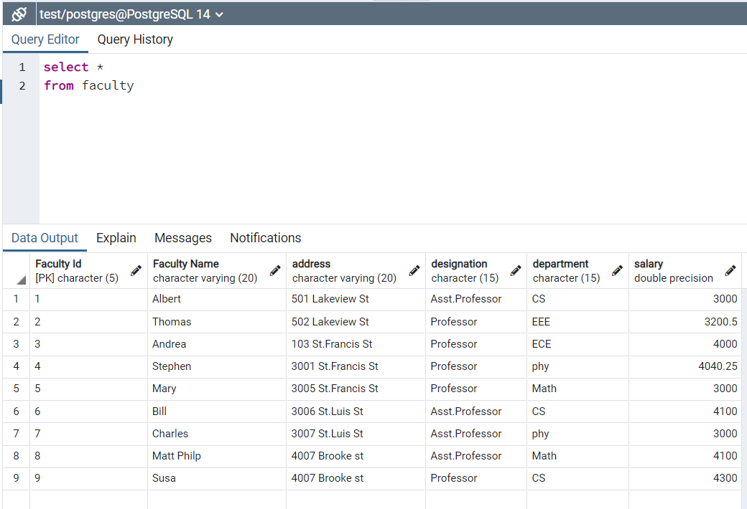
SQL QUERY
Updated records with department name and salary column.
update faculty set Department= 'CS',Salary= '3000' where "Faculty Id" = '1';
update faculty set Department= 'EEE',Salary= '3200.50' where "Faculty Id" = '2';
update faculty set Department= 'ECE',Salary= '4000' where "Faculty Id" = '3';
update faculty set Department= 'phy',Salary= '4040.25' where "Faculty Id" = '4';
update faculty set Department= 'Math',Salary= '3000' where "Faculty Id" = '5';
update faculty set Department= 'CS',Salary= '4100' where "Faculty Id" = '6';
update faculty set Department= 'phy',Salary= '3000' where "Faculty Id" = '7';
update faculty set Department= 'Math',Salary= '4100' where "Faculty Id" = '8';
update faculty set Department= 'CS',Salary= '4300' where "Faculty Id" = '9';

Slide 9
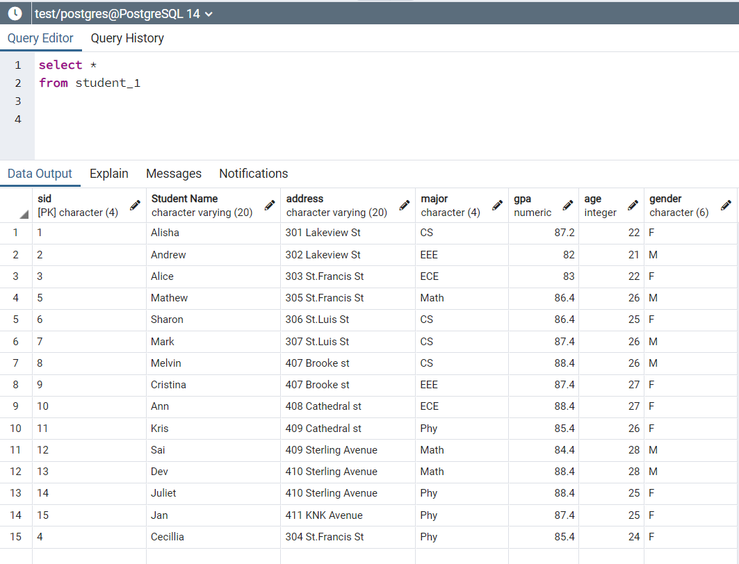
Student_1 relation:

Slide 10
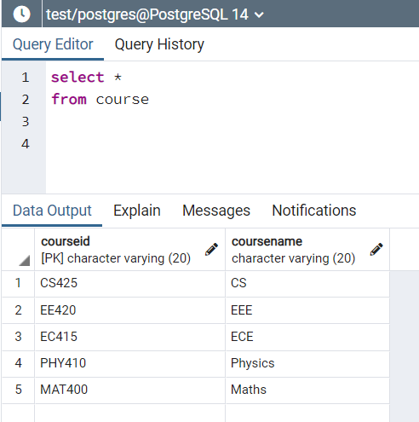
Course Relation:

Slide 11
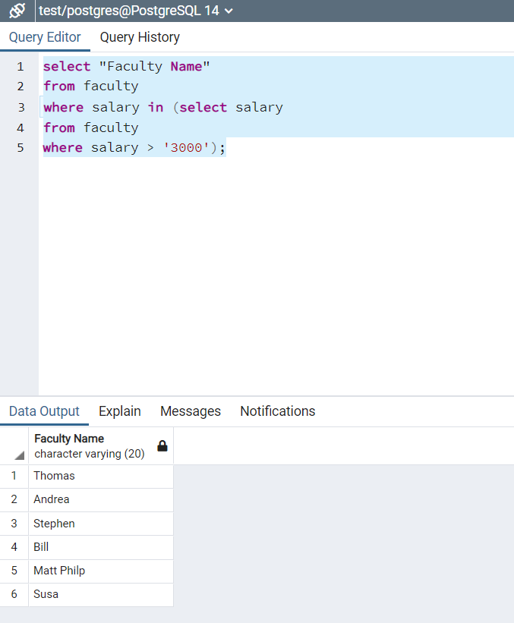
Sub Query 1
Output:
Query to list Faculty name whose salary >3000:
select "Faculty Name"
from faculty
where salary in (select salary
from faculty
where salary > '3000');

Slide 12
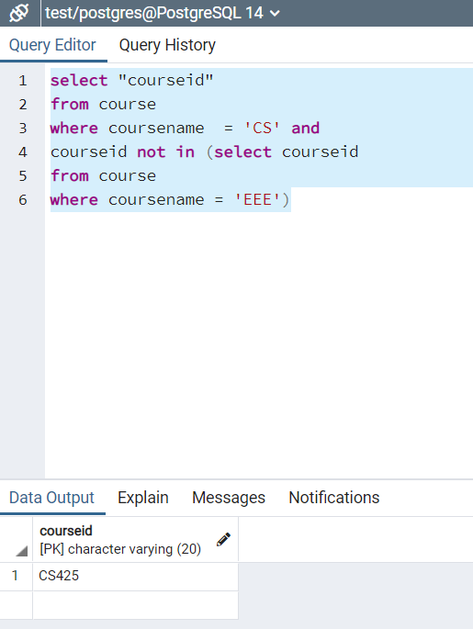
Sub Query 2
Output:
Query to find Course id of CS department:
select "courseid"
from course
where coursename = 'CS' and
courseid not in (select courseid
from course
where coursename = 'EEE')

Slide 13
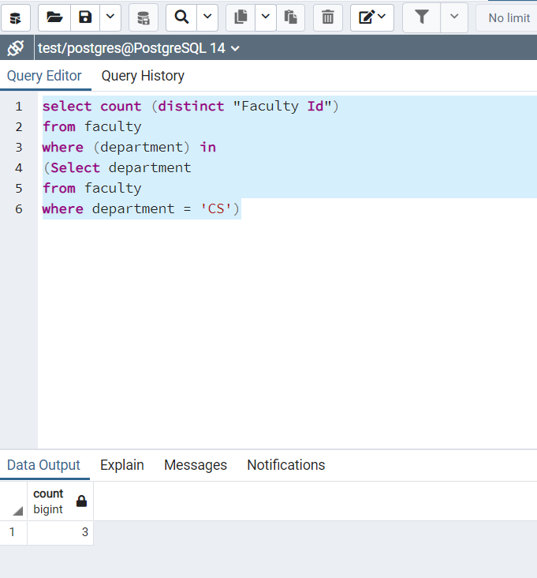
Sub Query 3
Output:
Query to find the Number of Faculty in ‘CS’ department:
select count (distinct "Faculty Id")
from faculty
where (department) in
(Select department
from faculty
where department = 'CS')

Slide 14
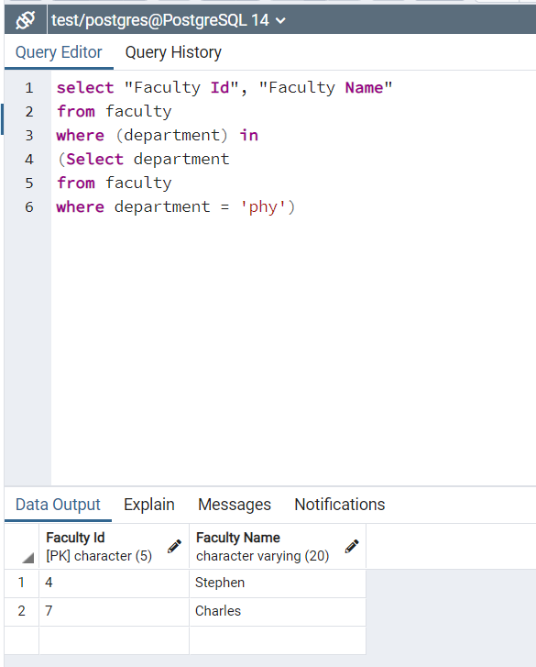
Query to list Faculty of Physics Department:
select "Faculty Id", "Faculty Name"
from faculty
where (department) in
(Select department
from faculty
where department = 'phy')
Sub Query 4
Output:

Slide 15
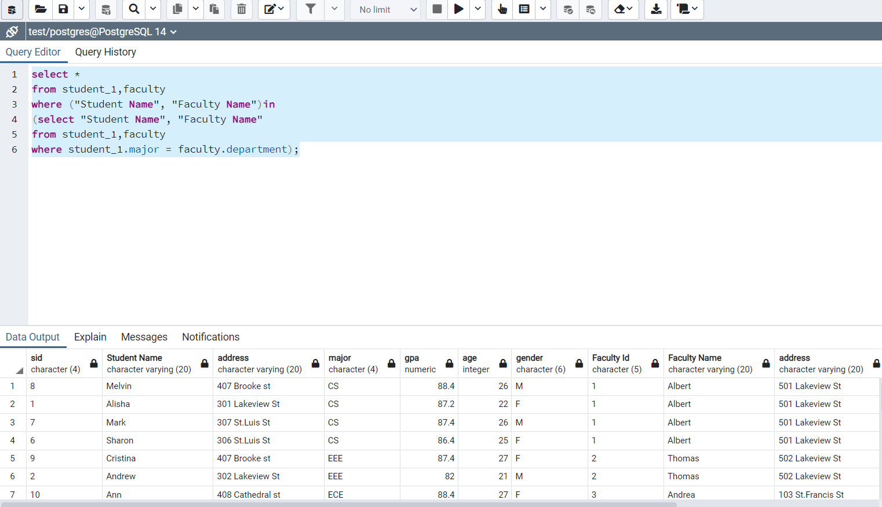
Query to List Students and faculty details:
select *
from student_1,faculty
where ("Student Name", "Faculty Name")in
(select "Student Name", "Faculty Name"
from student_1,faculty
where student_1.major = faculty.department);
Sub Query 5
Output

Slide 16
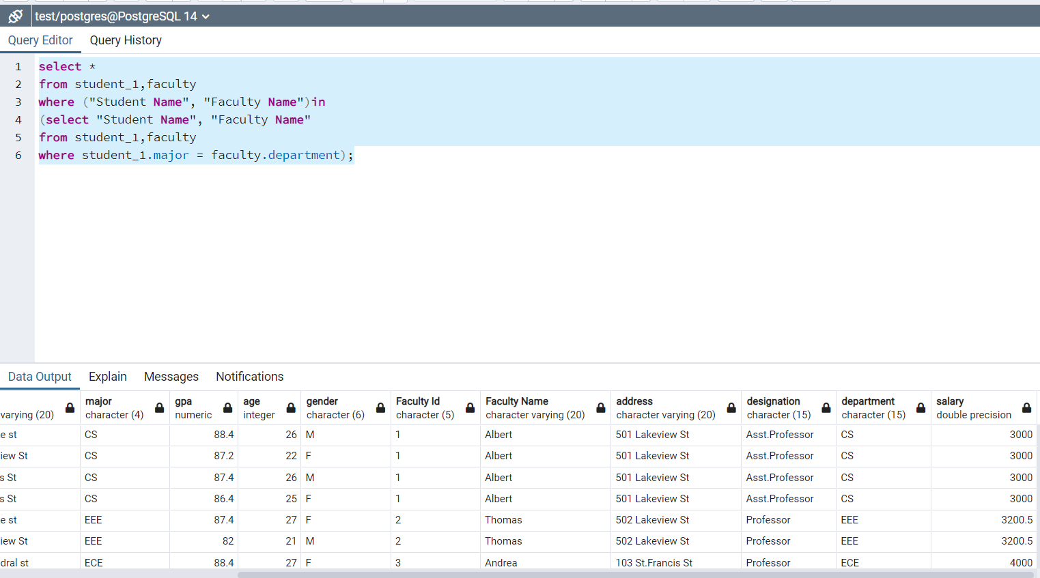

Slide 17
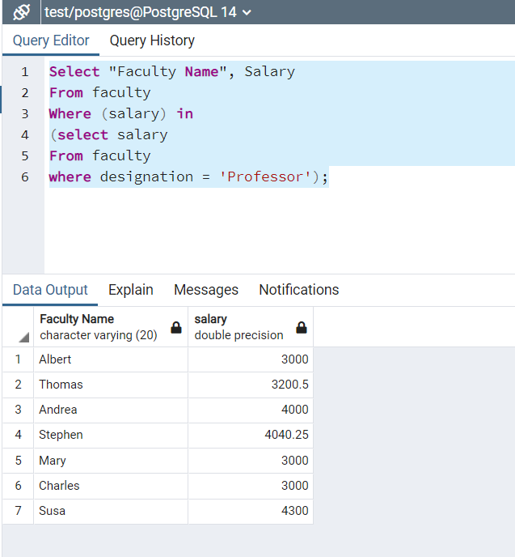
Sub Query 6
Output:
Query to find salary Details for faculty with designation - Professor:
Select "Faculty Name", Salary
From faculty
Where (salary) in
(select salary
From faculty
where designation = 'Professor');

Slide 18
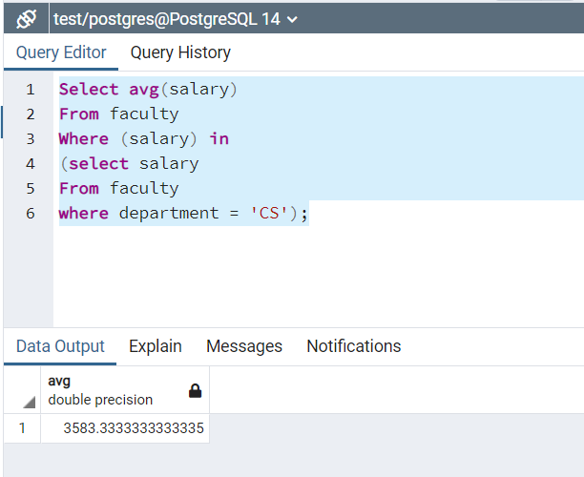
Sub Query 7
Output:
Query to find Avg Salary of CS department:
Select avg(salary)
From faculty
Where (salary) in
(select salary
From faculty
where department = 'CS');

Slide 19
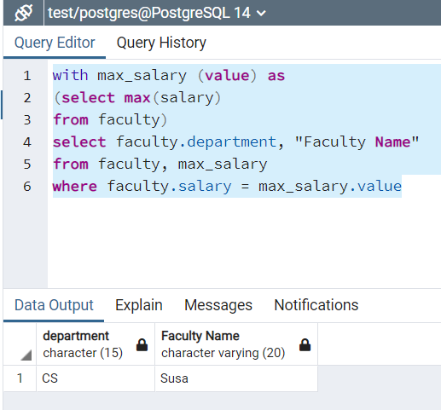
Sub Query 8:
Output:
Query to find department withMaximum salary :
with max_salary (value) as
(select max(salary)
from faculty)
select faculty.department, "Faculty Name"
from faculty, max_salary
where faculty.salary = max_salary.value

Slide 20
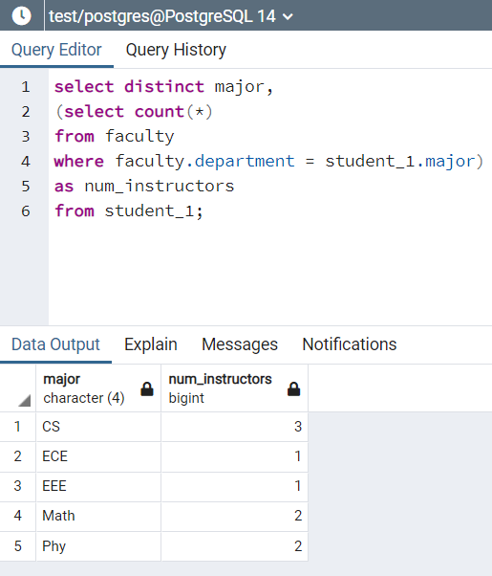
Sub Query 9:
Output:
Query to find no of instructors of each department:
select disctinct major,
(select count(*)
from faculty
where faculty.department = student_1.major)
as num_instructors
from student_1;

Slide 21
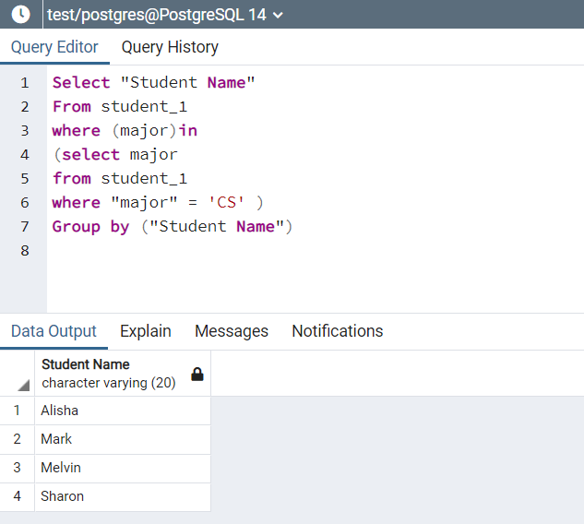
Sub Query 10:
Output:
Query to find students part of CS department:
Select "Student Name"
From student_1
where (major)in
(select major
from student_1
where "major" = 'CS' )
Group by ("Student Name")

